Slide 1
GitOps Club:
The first rule of GitOps club is talk about GitOps club
(to anyone who will listen 📢)

Slide 2

GitOps
Notes:
Talk about how we use gitops out in the wild
Share some of the things we’ve learnt
Inspire you to apply some / all in of the principles your workplace
Not much time for detail today, but do reach out

Slide 3


Slide 4
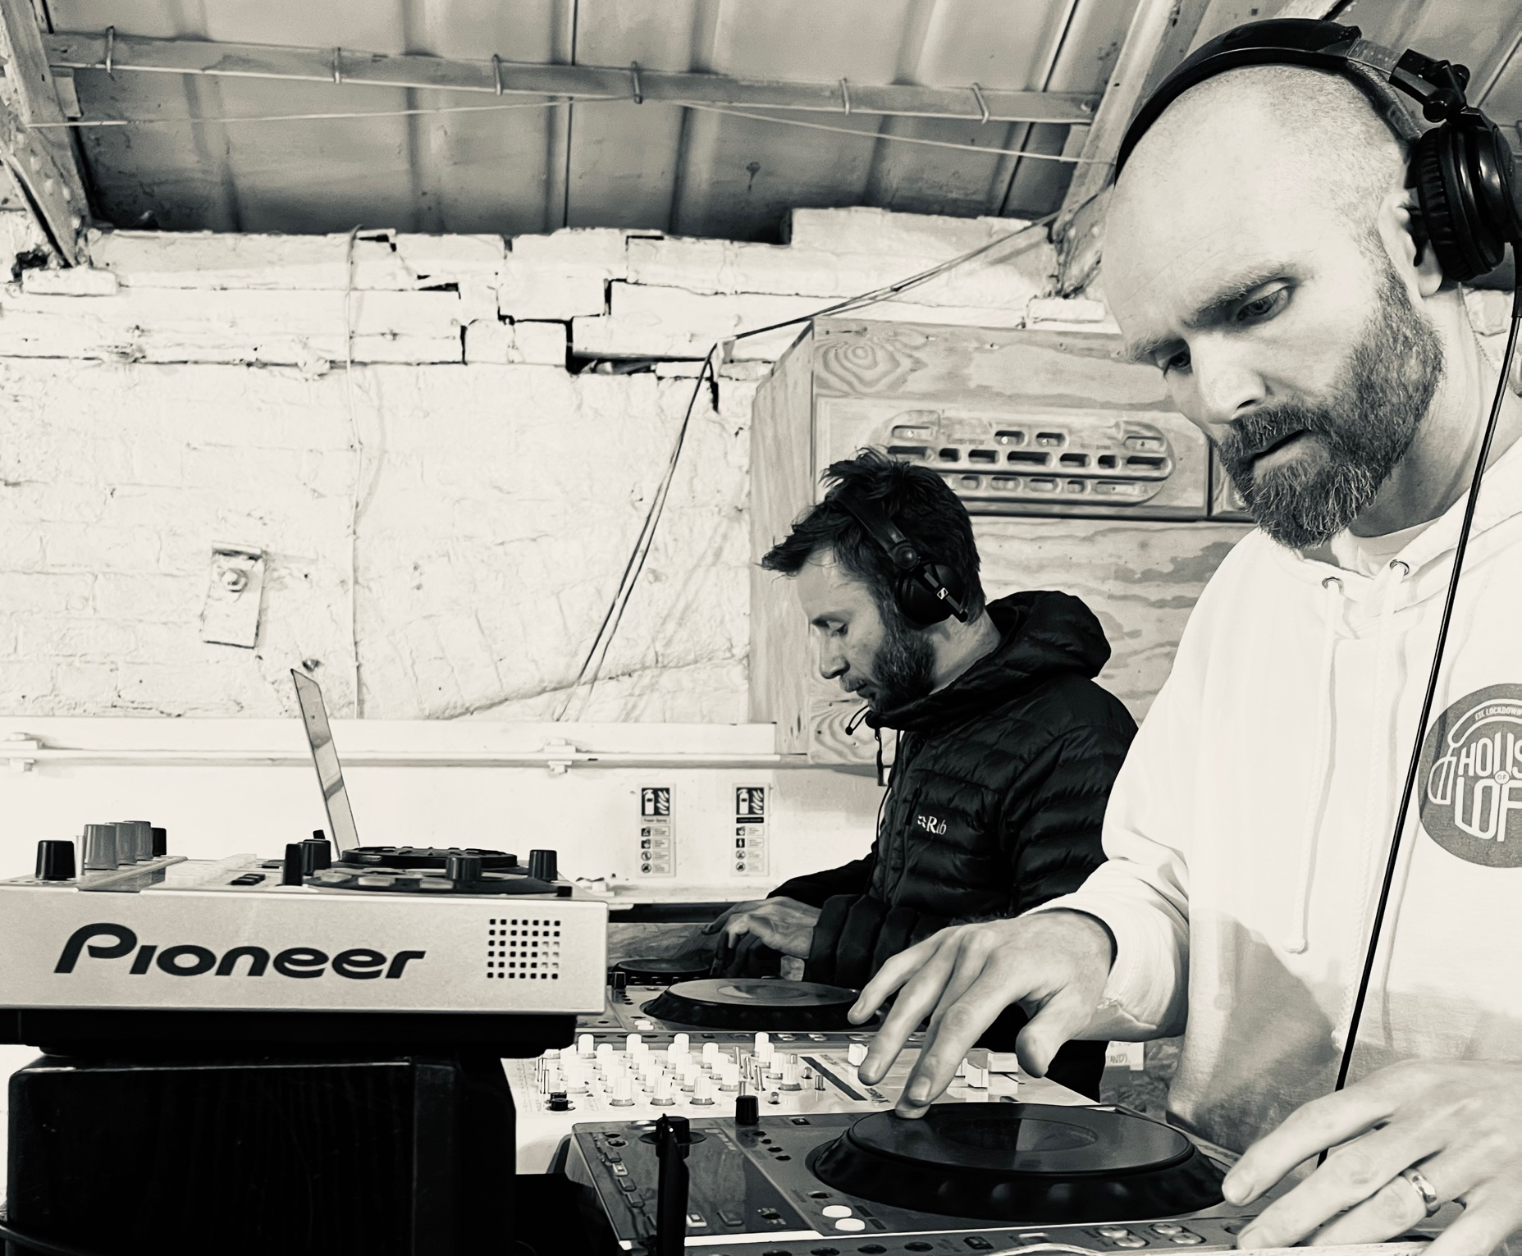
Hello
Notes:
Cloud architect at Burendo
AWS partners
20+ years designing and building enterprise and consumer apps
Last 5 years in NHS and Govt
Primarily in AWS

Slide 5
Git
Notes:
Show of hand who uses….
Git / Subversion / TFS / other VCS
Branches
CI / CD => GitHub Actions / GitLab CI / Bamboo / Circle CI / Jenkins / Others
Ioc => Terraform / CloudFormation / Others

Slide 6
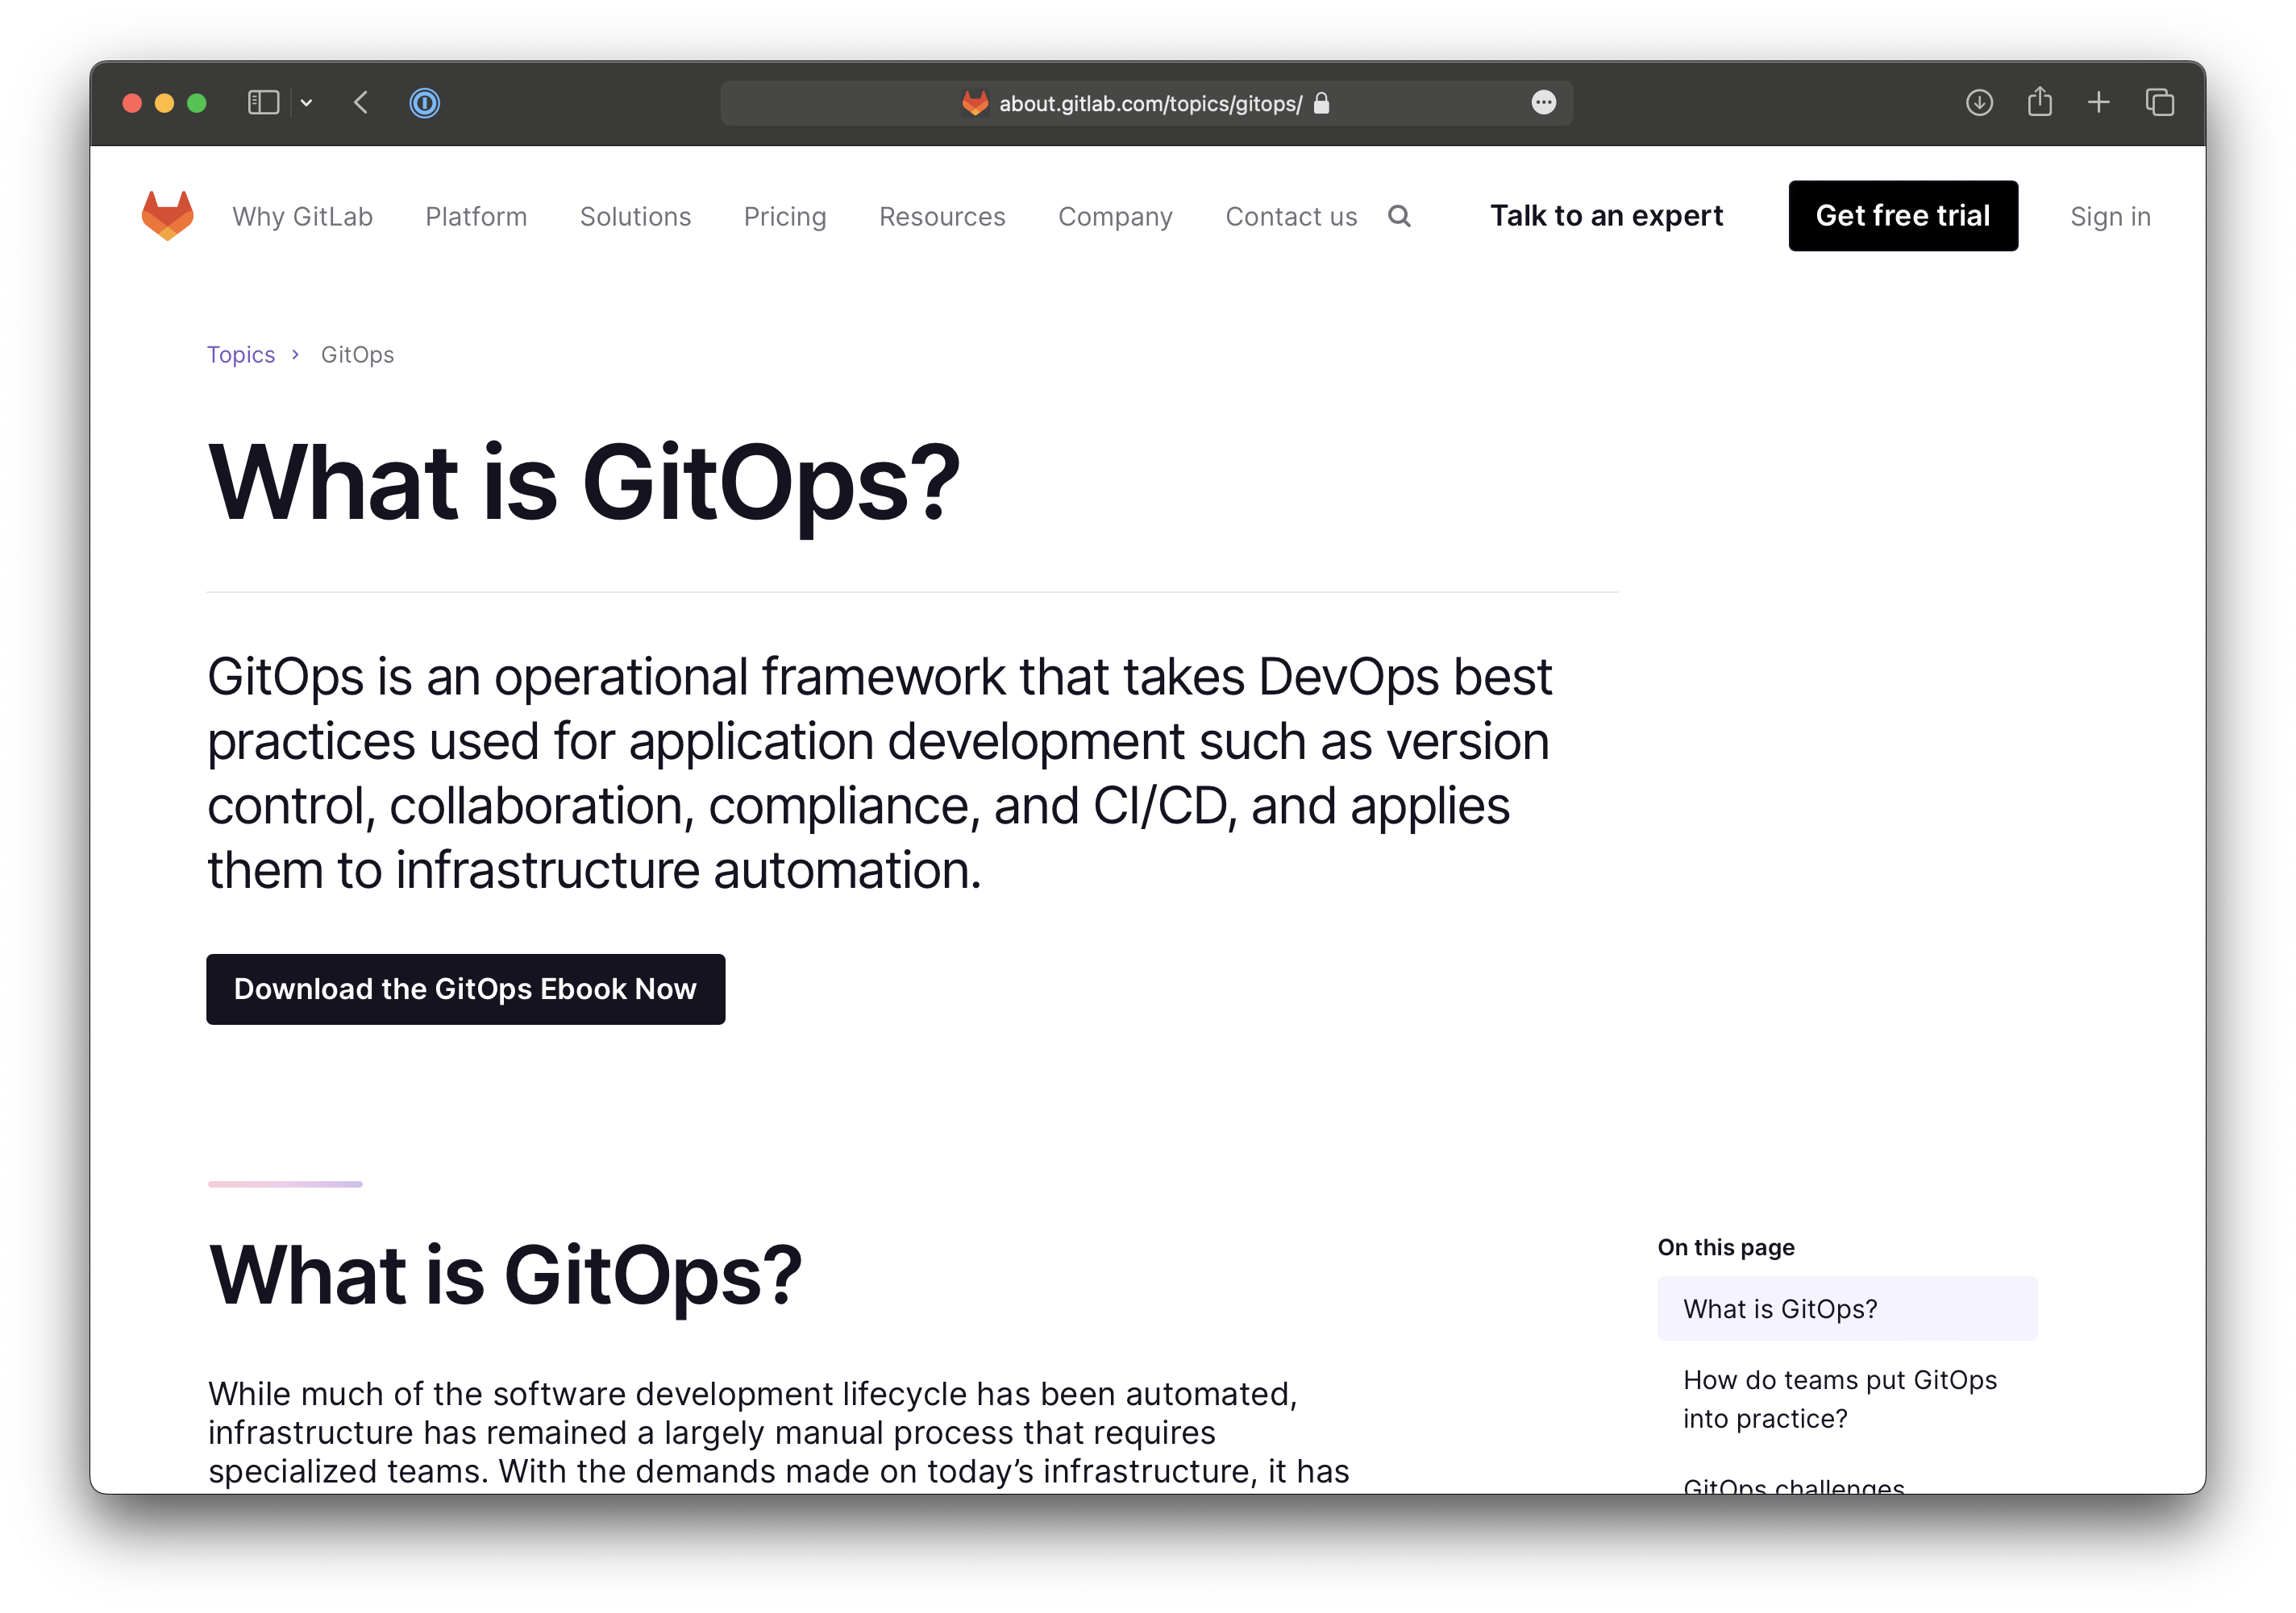
Git What?
Notes:
Quick google
GitLab sum it up nicely
Best bits of dev ops and apply to infrastructure automation
Lots of different definitions
Git is the source of truth
Talk about how we apply and practice git ops

Slide 7
Why should I use GitOps?

Slide 8
#1
Reduce risk
Notes:
Well architected framework show of hands
Operational excellence
Security
Reliability
Performance Efficiency
Cost optimization
Sustablity
De risk production deployments
Remove the need for humans to do deployments and make mistakes
Robust repeatable processes
Small changes are less risky than big ones

Slide 9
#2
Deliver value faster
Notes:
What we’re all here for – to build and ship products
Build it, ship it, get it used
Move quickly and and delivery value to customers at pace
Job Zero on any project – must be able to ship software (working or otherwise)
Much easier to do in the cloud

Slide 10
Used in the wild
to deliver…

Slide 11
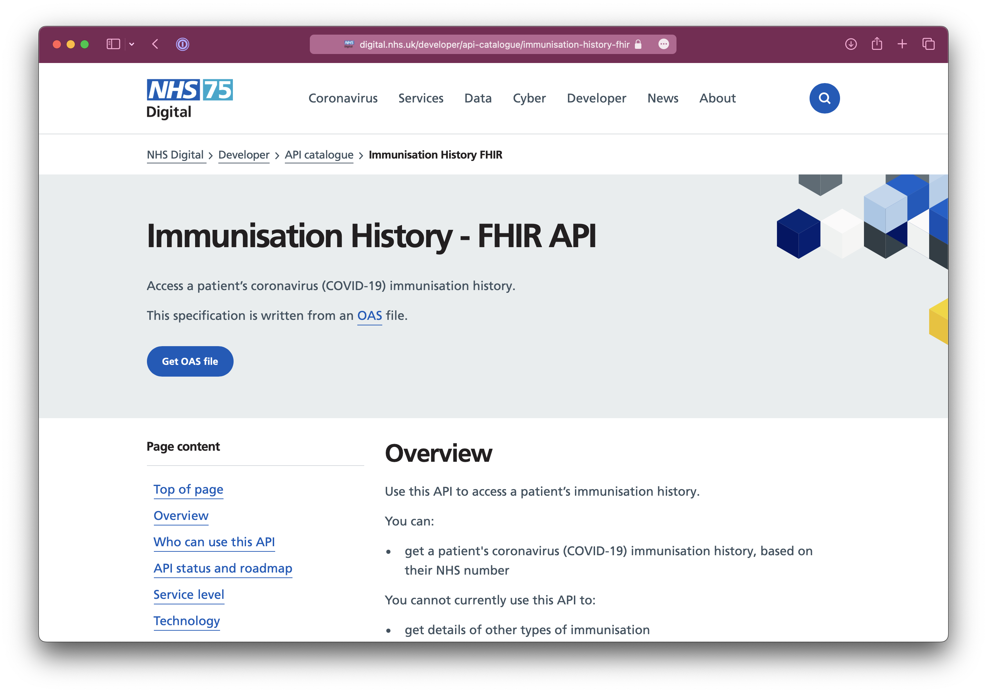
Notes:
COVID pass

Slide 12
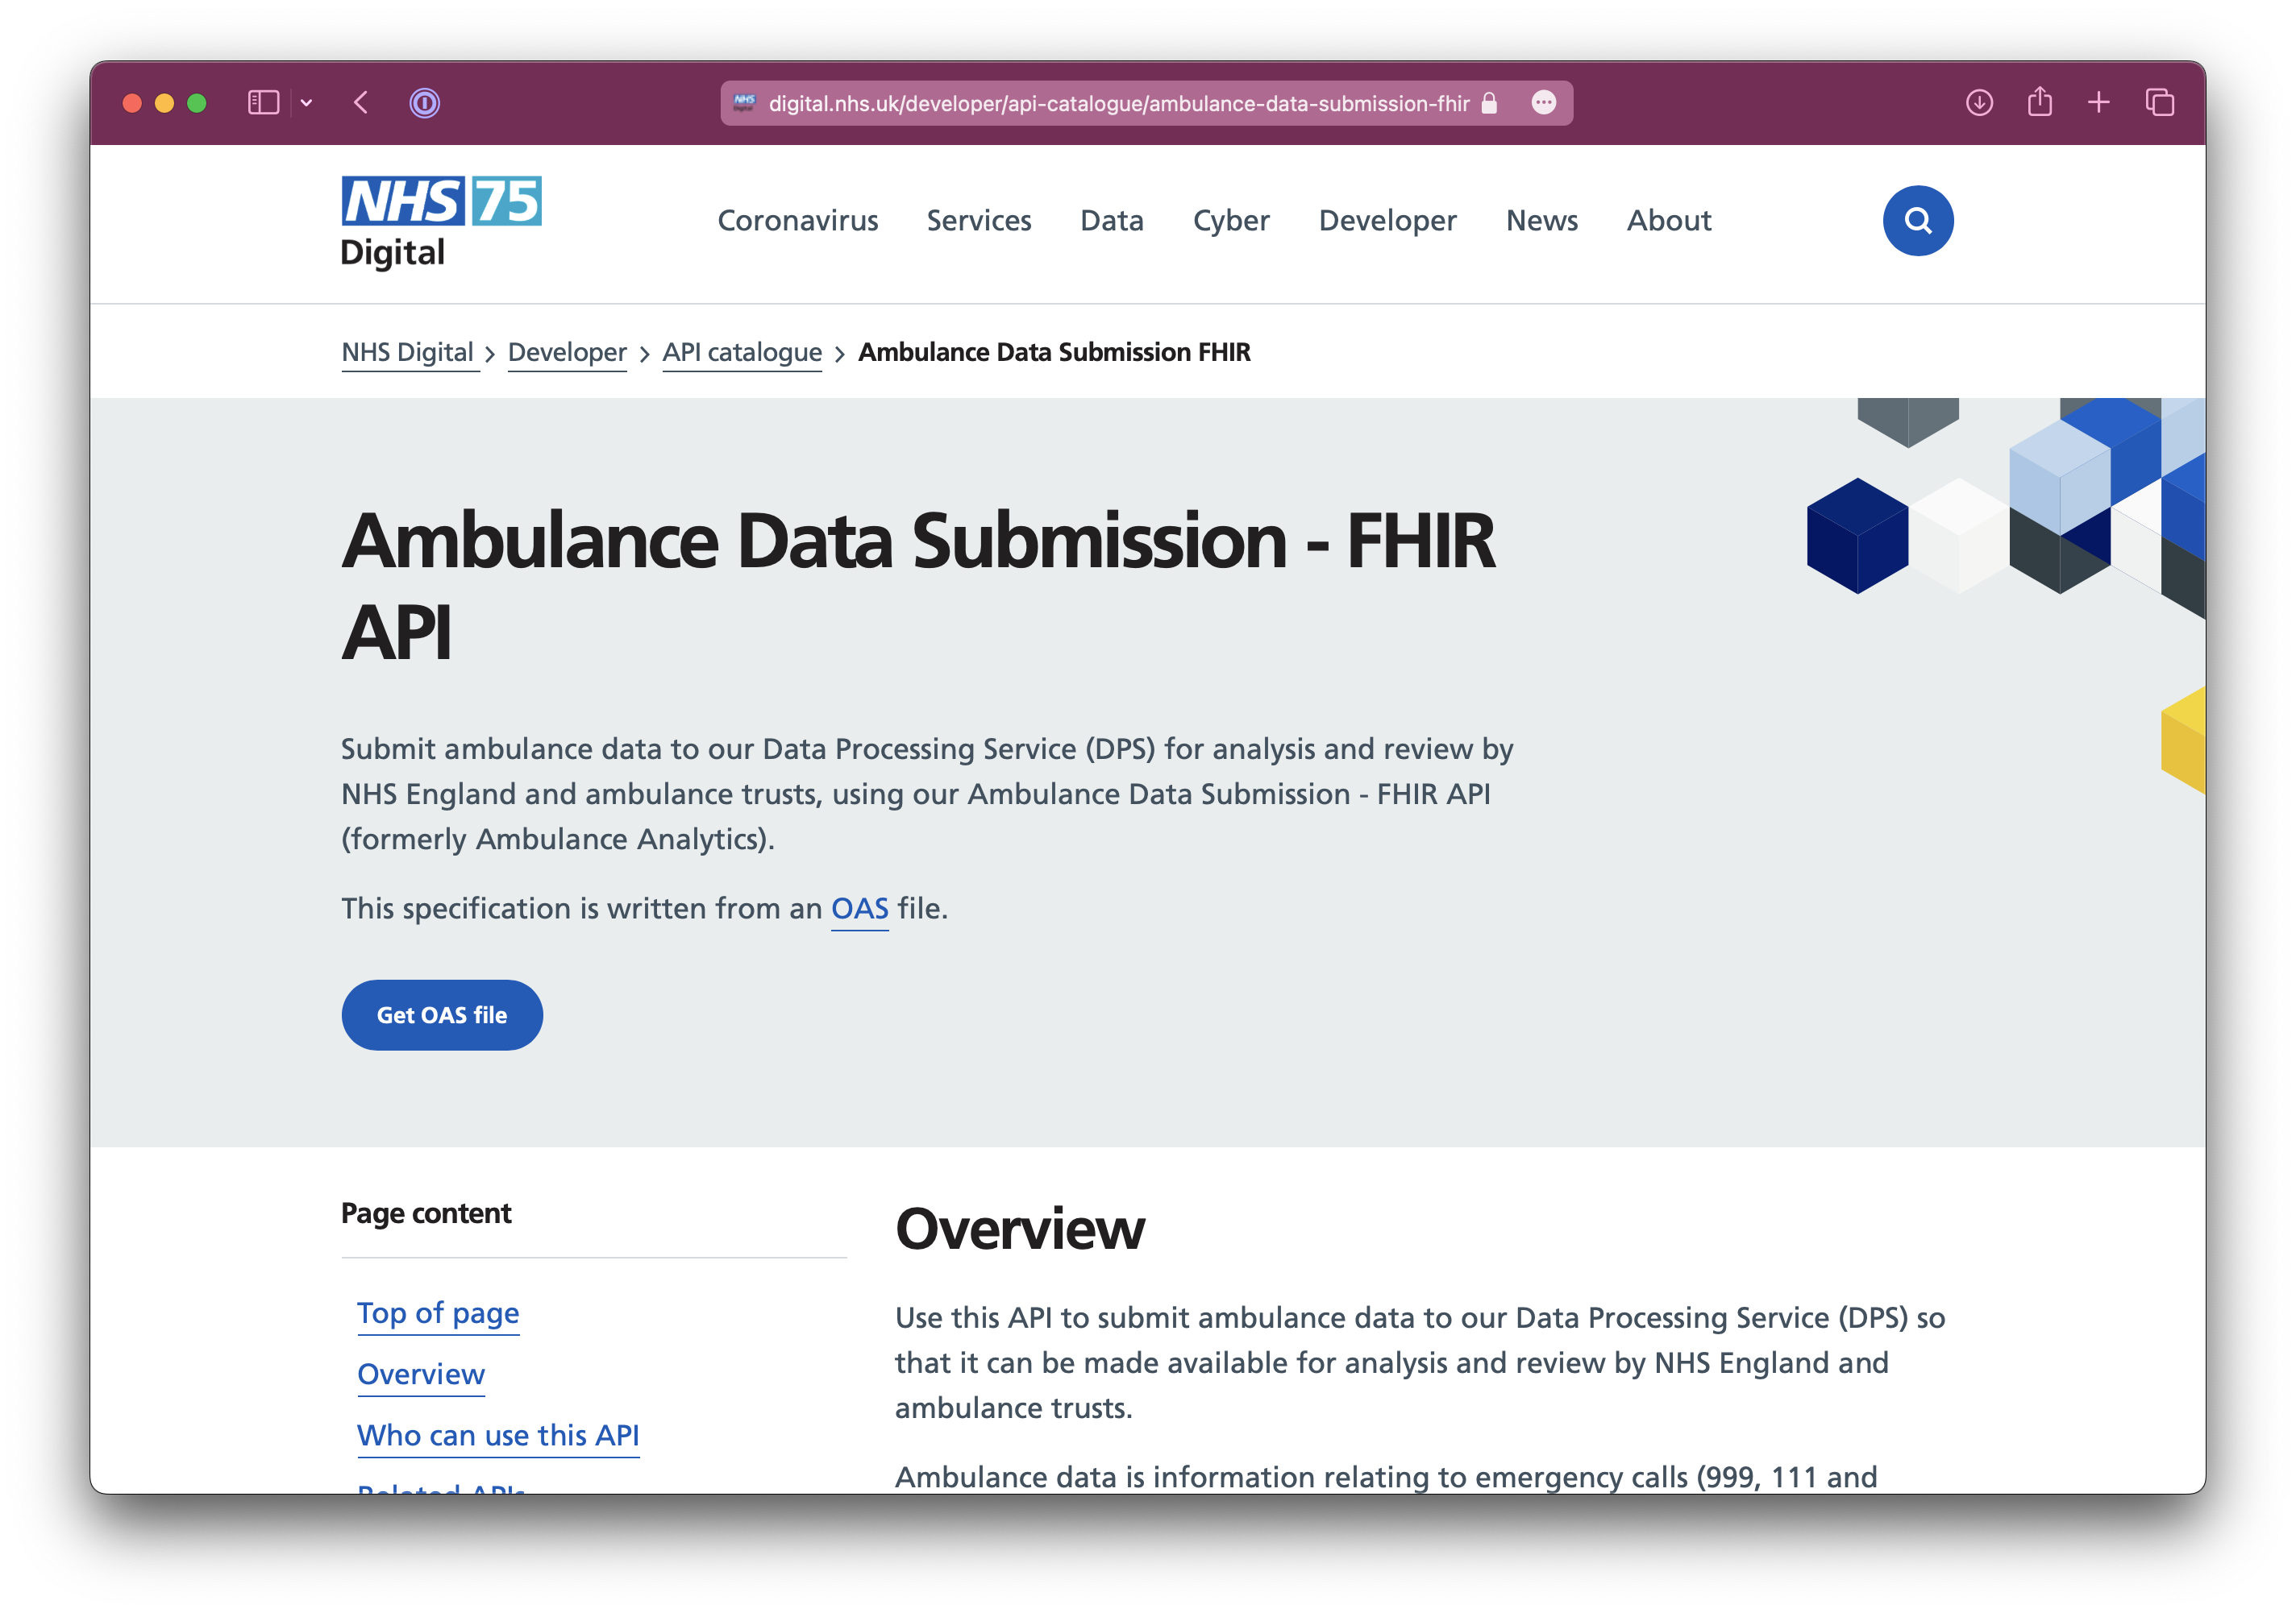
Notes:
Ambulance dispatch

Slide 13
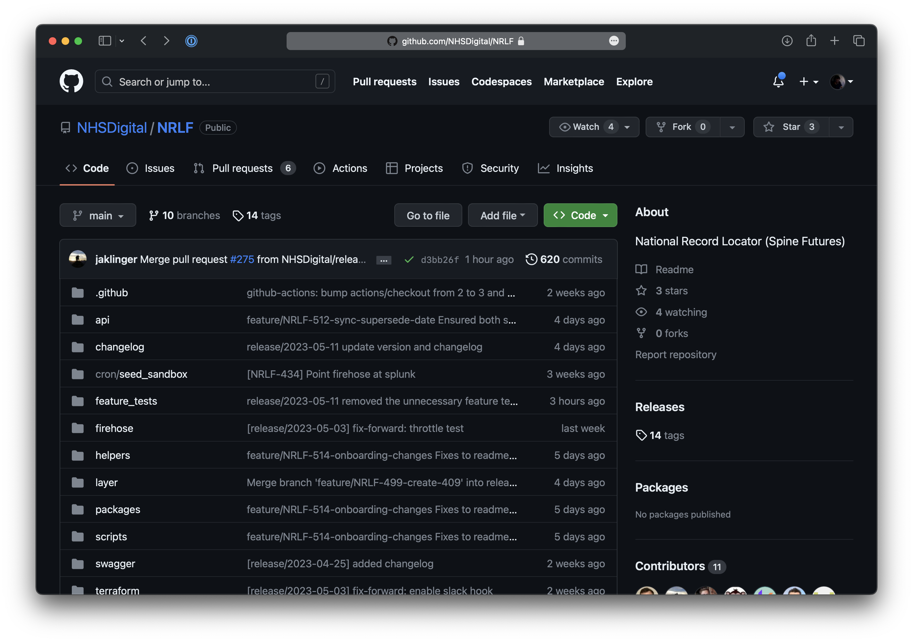
Notes:
National Record Locator
Think of it as a Yellow Pages for clinical records, connecting the whole Nation. It’s an index of pointers to data, but not the data itself. Allowing an ambulance service in London to find a Mental Health Crisis plan that exists in Leeds.
An index of clinical records, which connects the whole of England, regardless of organisation structures.

Slide 14
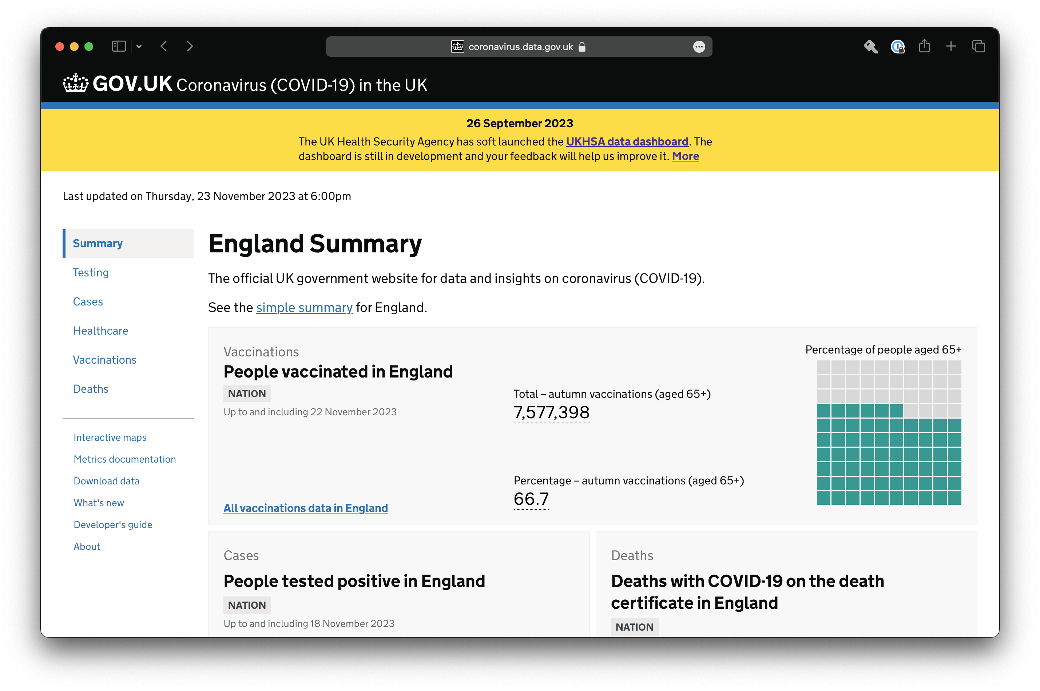
Notes:
Embargo
Will be open source

Slide 15
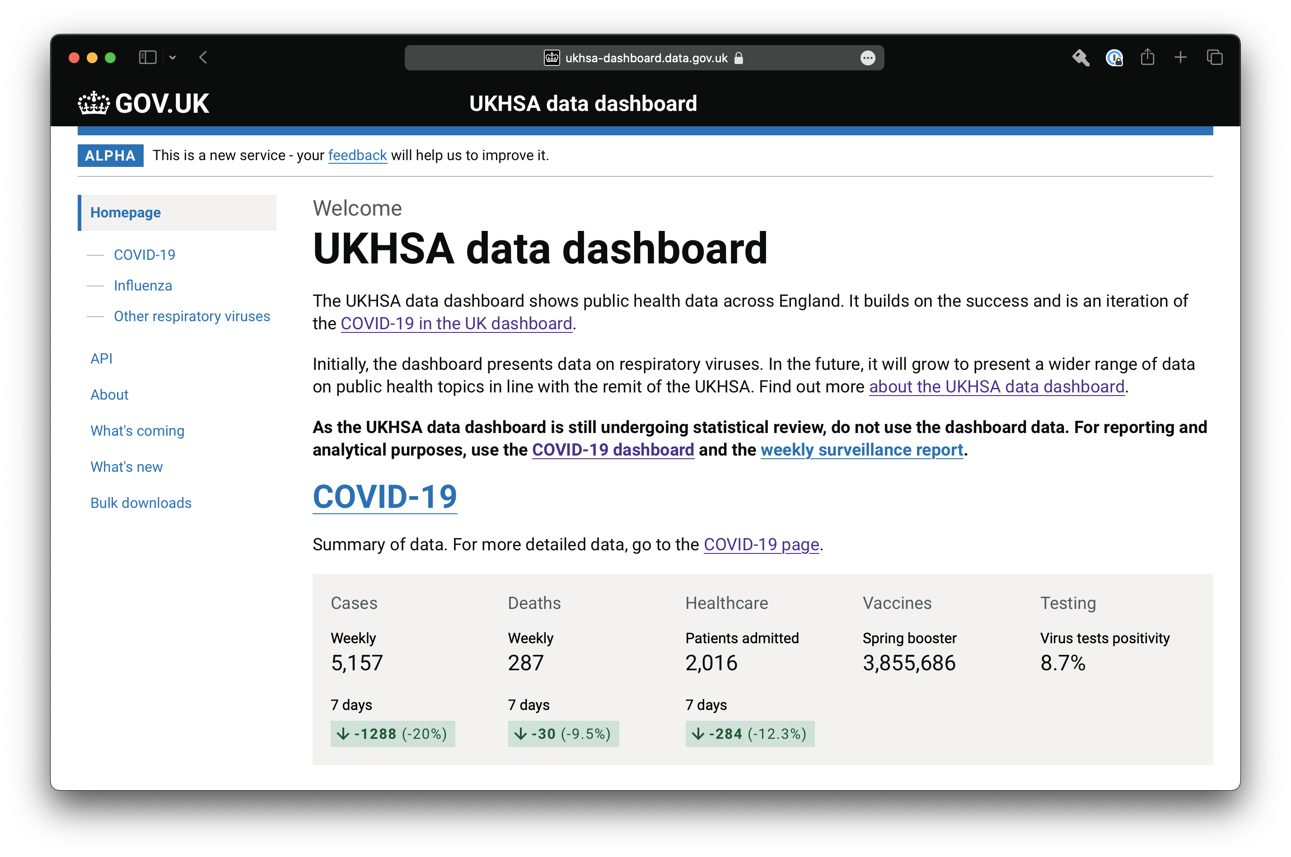
Notes:
Embargo
Will be open source

Slide 16
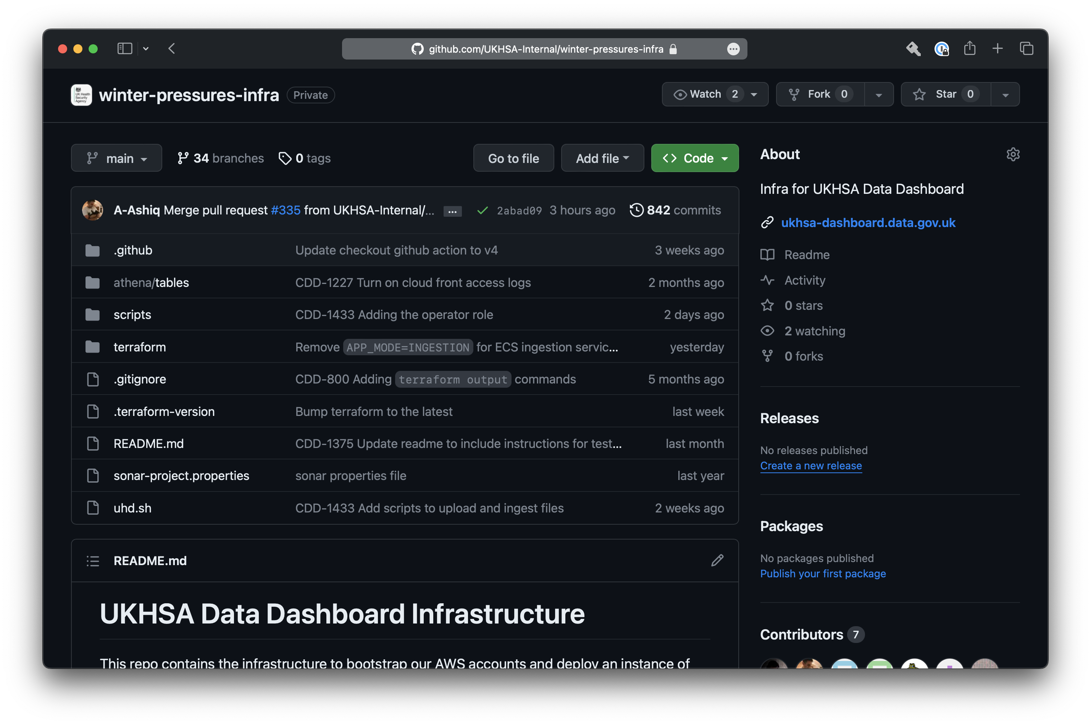
Notes:
Embargo
Will be open source

Slide 17
The rules
Notes:
8 rules / principles

Slide 18
The rules
Notes:
8 rules / principles

Slide 19
The principles
Notes:
8 rules / principles

Slide 20
#1
You must talk about
GitOps club 📢
Notes:
Obvs. It’s a fight club theme
More you talk and promote, then more stakeholders will engage and want to what is and will be onboard when you want to make the change

Slide 21
#2
Git is the source of truth
Notes:
Branches map to environments
Easy to see what is deployed where
Infra is defined in code alongside application source code
Entire running instance of the app can be stood up from code in repo
Enables the later rules
No need for other tool to manage deployments to other envs
Gilab CI / GitHub Actions

Slide 22
#3
Little and often
Notes:
De risk = small change is less risky than big changes
One ticket == one PR
Helps keep tickets small and concise
Easier to design, build, test, and deploy
Feature flags

Slide 23
#4
Automate all the things
Notes:
IoC
Cloud
Much easier with serverless
Can be done with containers / EC2 / Servers
Testing – unit vs integration vs e2e – hard to find the right balance
Dependabot for automated dependency updates
Zero (or close to) down time deployments
Deploy any time you like
No more out of hours deployments

Slide 24
#5
Feature branches for
dev work
Notes:
Workflow
GitHub flow => branch from main, code, open pr, review, test, merge
GitFlow when needed
PR => stand up new environment, infra + app changes, test
Every engineer has their own isolated env
No distinction between software engineers / test engineers
Need right caliber of people / upskill as needed

Slide 25
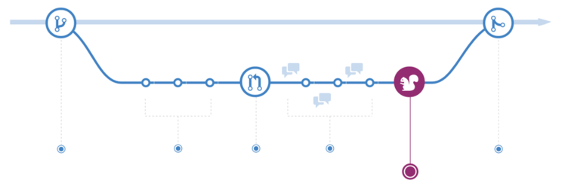
Notes:
Workflow
GitHub flow => branch from main, code, open pr, review, test, merge
GitFlow when needed
PR => stand up new environment, infra + app changes, test
Every engineer has their own isolated env
No distinction between software engineers / test engineers
Need right caliber of people / upskill as needed

Slide 26
Notes:
Workflow
GitHub flow => branch from main, code, open pr, review, test, merge
GitFlow when needed
PR => stand up new environment, infra + app changes, test
Every engineer has their own isolated env
No distinction between software engineers / test engineers
Need right caliber of people / upskill as needed

Slide 27
Notes:
Workflow
GitHub flow => branch from main, code, open pr, review, test, merge
GitFlow when needed
PR => stand up new environment, infra + app changes, test
Every engineer has their own isolated env
No distinction between software engineers / test engineers
Need right caliber of people / upskill as needed

Slide 28
Notes:
Workflow
GitHub flow => branch from main, code, open pr, review, test, merge
GitFlow when needed
PR => stand up new environment, infra + app changes, test
Every engineer has their own isolated env
No distinction between software engineers / test engineers
Need right caliber of people / upskill as needed

Slide 29
Notes:
Workflow
GitHub flow => branch from main, code, open pr, review, test, merge
GitFlow when needed
PR => stand up new environment, infra + app changes, test
Every engineer has their own isolated env
No distinction between software engineers / test engineers
Need right caliber of people / upskill as needed

Slide 30
Notes:
Workflow
GitHub flow => branch from main, code, open pr, review, test, merge
GitFlow when needed
PR => stand up new environment, infra + app changes, test
Every engineer has their own isolated env
No distinction between software engineers / test engineers
Need right caliber of people / upskill as needed

Slide 31
Notes:
Workflow
GitHub flow => branch from main, code, open pr, review, test, merge
GitFlow when needed
PR => stand up new environment, infra + app changes, test
Every engineer has their own isolated env
No distinction between software engineers / test engineers
Need right caliber of people / upskill as needed

Slide 32
Notes:
Workflow
GitHub flow => branch from main, code, open pr, review, test, merge
GitFlow when needed
PR => stand up new environment, infra + app changes, test
Every engineer has their own isolated env
No distinction between software engineers / test engineers
Need right caliber of people / upskill as needed

Slide 33
Notes:
Workflow
GitHub flow => branch from main, code, open pr, review, test, merge
GitFlow when needed
PR => stand up new environment, infra + app changes, test
Every engineer has their own isolated env
No distinction between software engineers / test engineers
Need right caliber of people / upskill as needed

Slide 34
stand up new environment
Notes:
Workflow
GitHub flow => branch from main, code, open pr, review, test, merge
GitFlow when needed
PR => stand up new environment, infra + app changes, test
Every engineer has their own isolated env
No distinction between software engineers / test engineers
Need right caliber of people / upskill as needed

Slide 35
#6
Branches for well known
environments
Notes:
Main == prod
Use branch convention for well know envs such are uat, staging, test, pen etc.
Protect branches
No UAT. PO freak out
Have as many as you link / need.
Stand up new ones as when / needed.
Map to external system dependencies when needed.

Slide 36
main
Notes:
Main == prod
Use branch convention for well know envs such are uat, staging, test, pen etc.
Protect branches
No UAT. PO freak out
Have as many as you link / need.
Stand up new ones as when / needed.
Map to external system dependencies when needed.

Slide 37
env/uat
main
Notes:
Main == prod
Use branch convention for well know envs such are uat, staging, test, pen etc.
Protect branches
No UAT. PO freak out
Have as many as you link / need.
Stand up new ones as when / needed.
Map to external system dependencies when needed.

Slide 38
env/uat
main
env/foo
Notes:
Main == prod
Use branch convention for well know envs such are uat, staging, test, pen etc.
Protect branches
No UAT. PO freak out
Have as many as you link / need.
Stand up new ones as when / needed.
Map to external system dependencies when needed.

Slide 39
#7
Merge or push to trigger
a deployment
Notes:
Automation ++
Deployment pipeline
Merge to Main => prod
Push to WKE triggers deployment
Automate fast forward merges etc to keep all envs up to date

Slide 40
main
Notes:
Automation ++
Deployment pipeline
Merge to Main => prod
Push to WKE triggers deployment
Automate fast forward merges etc to keep all envs up to date

Slide 41
prod
main
Notes:
Automation ++
Deployment pipeline
Merge to Main => prod
Push to WKE triggers deployment
Automate fast forward merges etc to keep all envs up to date

Slide 42
prod
env/uat
main
Notes:
Automation ++
Deployment pipeline
Merge to Main => prod
Push to WKE triggers deployment
Automate fast forward merges etc to keep all envs up to date

Slide 43
prod
env/uat
uat
main
Notes:
Automation ++
Deployment pipeline
Merge to Main => prod
Push to WKE triggers deployment
Automate fast forward merges etc to keep all envs up to date

Slide 44
prod
env/uat
uat
main
env/foo
Notes:
Automation ++
Deployment pipeline
Merge to Main => prod
Push to WKE triggers deployment
Automate fast forward merges etc to keep all envs up to date

Slide 45
prod
env/uat
uat
main
env/foo
foo
Notes:
Automation ++
Deployment pipeline
Merge to Main => prod
Push to WKE triggers deployment
Automate fast forward merges etc to keep all envs up to date

Slide 46
#8
Always forwards,
never back
Notes:
Never back out a change
As all changes are done through PR, and each PR is small, simply revert the PR, and that’s another change to roll forwards
Bug fix / hot fixes are just the same as another small release – branch, PR, review, test, merge, deploy

Slide 47

Notes:
Don’t get too hung up on tooling
AWS => Code commit / deploy etc
GitHub + GitHub Actions
Gitlab + GitLab CI
BitBucket + Bamboo
etc
Use what you have to hand
Expect to write some code + scripts
Use what we’ve done for inspiration

Slide 48
But

Slide 49

My client / sponsor / PO
says no
Notes:
Start small – POC
Non critical app
Record metrics and monitor – tell the story
Sell the benefits
De risk
Ship value faster
Ask for forgiveness not permission
Be carful
Prove it out
Most people can be persuaded once they understand the benefits

Slide 50
Tell me more

Slide 51
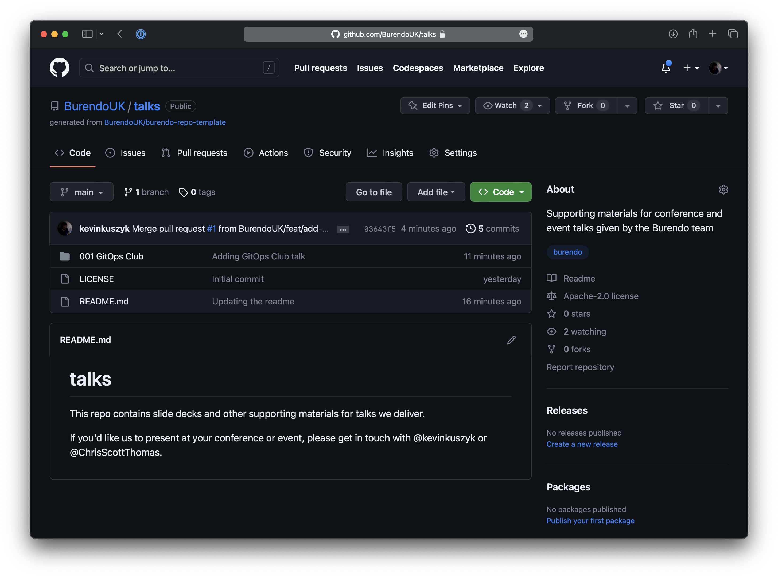

Slide 52
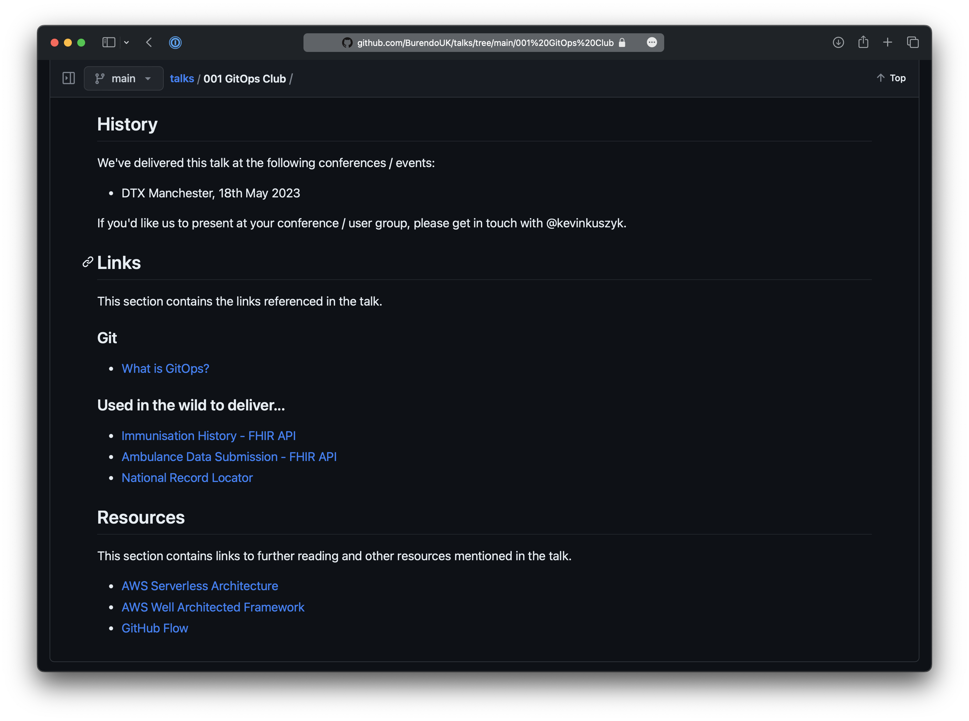

Slide 53

BurendoUK/talks
@kevinkuszyk
kevin.kuszyk@burendo.com

Slide 54
Thank you

